Slide 1
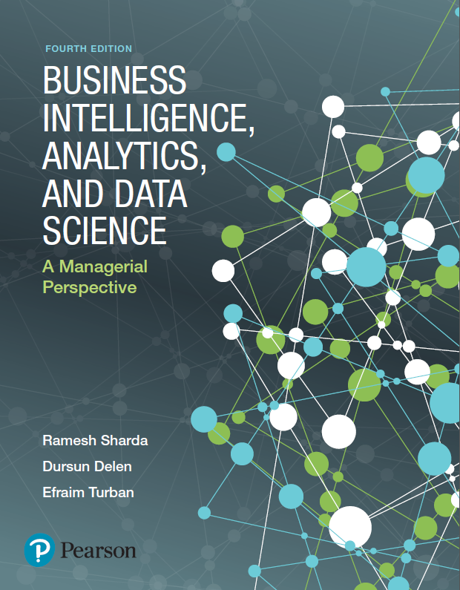
Business Intelligence, Analytics, and Data Science: A Managerial Perspective
Fourth Edition
Chapter 1
An Overview of Business Intelligence, Analytics, and Data Science
Slides in this presentation contain hyperlinks. JAWS users should be able to get a list of links by using INSERT+F7
Copyright © 2018, 2014, 2011 Pearson Education, Inc. All Rights Reserved
Notes:
If this PowerPoint presentation contains mathematical equations, you may need to check that your computer has the following installed:
1) MathType Plugin
2) Math Player (free versions available)
3) NVDA Reader (free versions available)

Slide 2
Learning Objectives
1.1 Understand the need for computerized support of managerial decision making
1.2 Recognize the evolution of such computerized support to the current state—analytics/data science
1.3 Describe the business intelligence (B I) methodology and concepts
1.4 Understand the various types of analytics, and see selected applications
1.5 Understand the analytics ecosystem to identify various key players and career opportunities
Notes:
Slide 2 is a list of textbook LO numbers and statements.

Slide 3
Opening Vignette (1 of 5)
Sports Analytics—An Exciting Frontier for Learning and Understanding Applications of Analytics
Sports analytics is becoming a specialty within analytics
Sports is a big business
Generating $145B in revenues annually
Additional $100B in legal and $300B in illegal gambling
Analytic in sports popularized by the Moneyball book by Michael Lewis in 2003
About Oakland A’s
And the follow-on movie in 2011
Nowadays, analytics is used in many facets of sports

Slide 4
Opening Vignette (2 of 5)
Example 1: The Business Office
Figure 1.1 Season Ticket Renewals—Survey Scores
Tier | Highly Likely | Likely | Maybe | Probably Not | Certainly Not
1 | 92 | 88 | 75 | 69 | 45
2 | 88 | 81 | 70 | 65 | 38
3 | 80 | 76 | 68 | 55 | 36
4 | 77 | 72 | 65 | 45 | 25
5 | 75 | 70 | 60 | 35 | 25

Slide 5
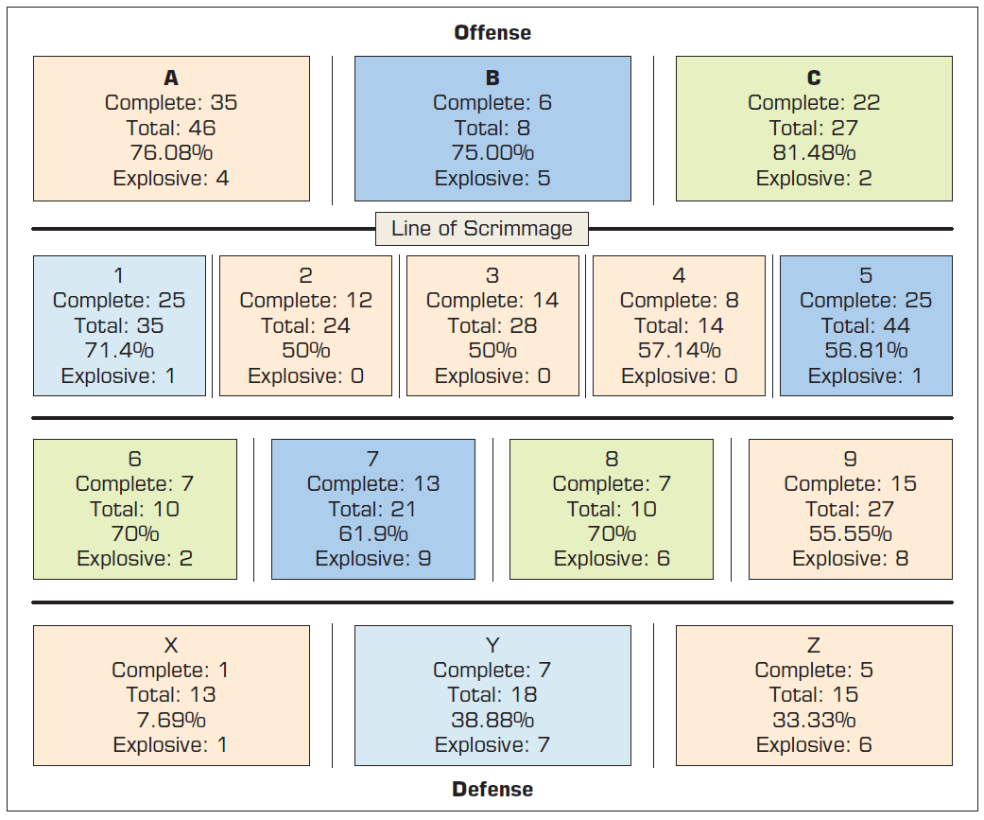
Opening Vignette (3 of 5)
Example 2: The Coach
Figure 1.4 Heat Map Zone Analysis for Passing Plays

Slide 6
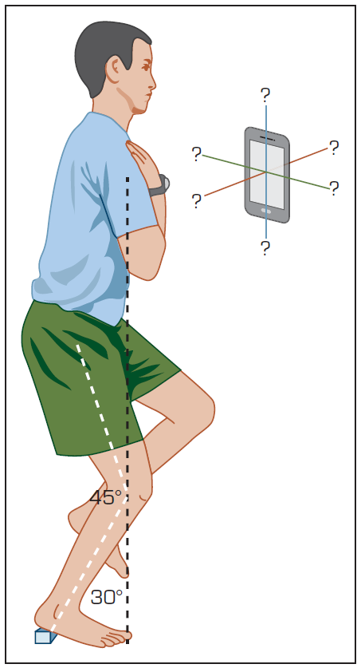
Opening Vignette (4 of 5)
Example 3: The Trainer
Figure 1.7 Single Leg Squat Hold Test – Core Body Strength Test
(Source: Wilkerson and Gupta).

Slide 7
Opening Vignette (5 of 5)
Discussion Questions
What are three factors that might be part of a P M for season ticket renewals?
What are two techniques that football teams can use to do opponent analysis?
How can wearables improve player health and safety? What kinds of new analytics can trainers use?
What other analytics applications can you envision in sports?

Slide 8
Changing Business Environments and Evolving Needs for Decision Support and Analytics
Increased hardware, software, and network capabilities
Group communication and collaboration
Improved data management
Managing giant data warehouses and Big Data
Analytical support
Overcoming cognitive limits in processing and storing information
Knowledge management
Anywhere, anytime support

Slide 9
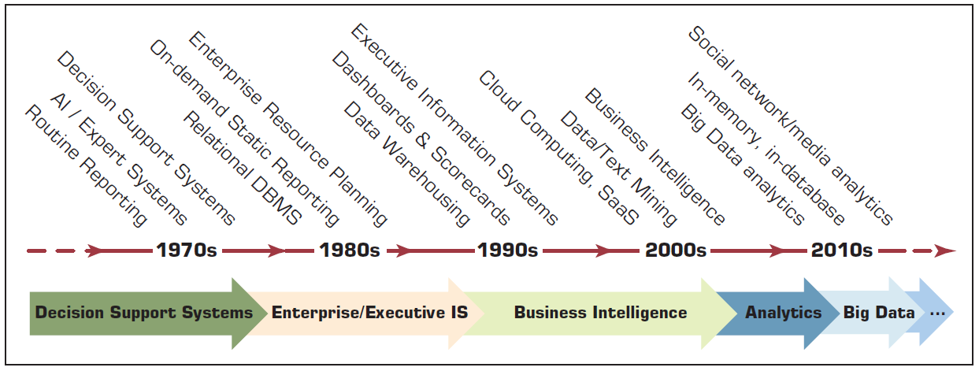
Evolution of Computerized Decision Support to Analytics/Data Science
Figure 1.8 Evolution of Decision Support, Business Intelligence, and Analytics

Slide 10
A Framework for Business Intelligence (1 of 3)
D S S → E I S → B I
Definition of Business Intelligence
[Broad Definition] An umbrella term that combines architectures, tools, databases, analytical tools, applications, and methodologies
[Narrow Definition] Descriptive analytics tools and techniques (i.e., reporting tools)
A Brief History of B I – 1970s → 1980s → 1990s …
The Origins and Drivers of B I (See Figure 1.9)
The Architecture of B I (See Figure 1.10)

Slide 11
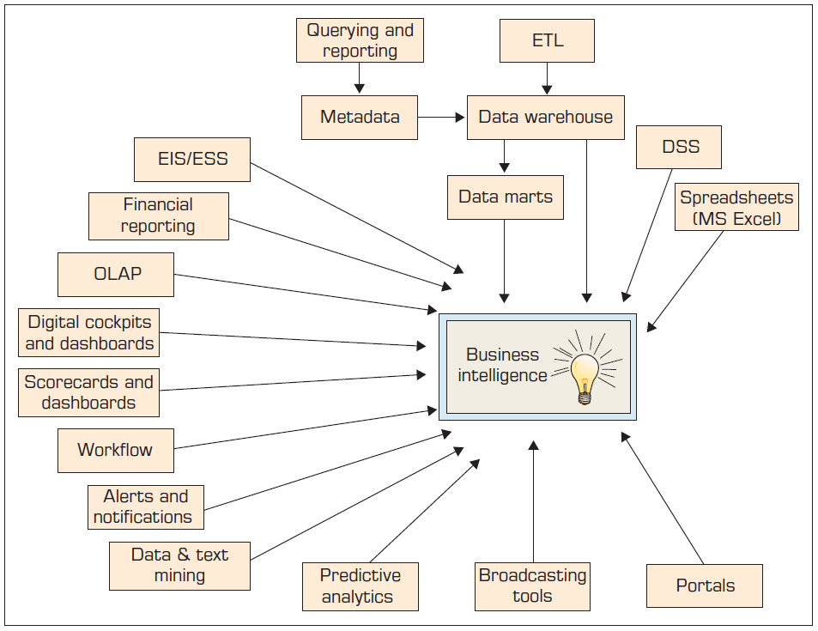
A Framework for Business Intelligence (2 of 3)
Figure 1.9 Evolution of Business Intelligence (B I) →

Slide 12
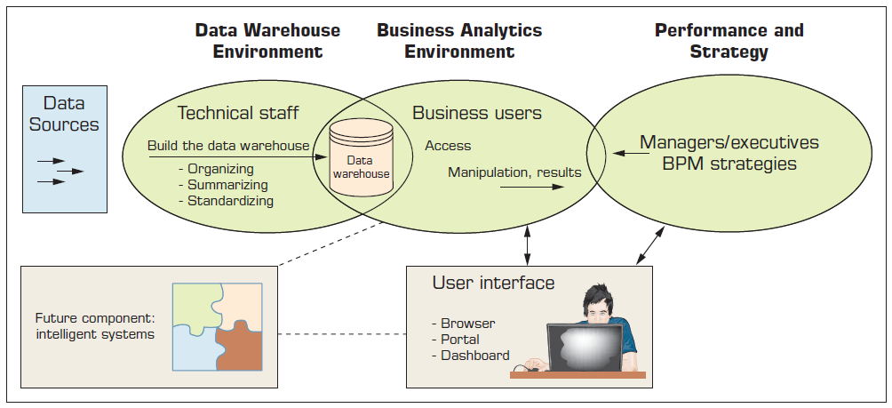
A Framework for Business Intelligence (3 of 3)
The Architecture of B I
Figure 1.10 A High-Level Architecture of B I

Slide 13
Application Case 1.1
Sabre Helps Its Clients through Dashboards and Analytics
Questions for Discussion
What is traditional reporting? How is it used in the organization?
How can analytics be used to transform the traditional reporting?
How can interactive reporting assist organizations in decision making?

Slide 14
A Multimedia Exercise in Business Intelligence
T U N (TeradataUniversityNetwork.com)
B S I Videos (Business Scenario Investigations)
Analogues to C S I (Crime Scene Investigation)
Go To
www.youtube.com/watch?v=NXEL5F4_aKA
See the
www.slideshare.net/teradata/bsi-how-we-did-it-the-case-of-the-misconnecting-passengers.slides
Discuss the case presented in the video and in the slides

Slide 15
Transaction Processing Versus Analytic Processing
Online Transaction Processing (O L T P)
Operational databases
E R P, S C M, C R M, …
Goal: data capture
Online Analytical Processing (O L A P)
Data warehouses
Goal: decision support
What is the relationship between O L T P and O L A P?

Slide 16
Appropriate Planning and Alignment with the Business Strategy
Planning and Execution → Business, Organization, Functionality, and Infrastructure
Functions served by B I Competency Center
How B I is linked to strategy and execution of strategy
Encourage interaction between the potential business user communities and the I S organization
Serve as a repository and disseminator of best B I practices between and among the different lines of business.
Standards of excellence in B I practices can be advocated and encouraged throughout the company

Slide 17
Real-Time, On-Demand B I is Attainable
Emergence of real-time B I applications
Justifying the need
Is there a need for real-time [is it worth the additional expense]?
Leveraging the enablers
R F I D
Web services
Intelligent agents

Slide 18
Critical B I System Considerations
Developing or Acquiring B I Systems
Make versus buy
B I shells
Justification and Cost–Benefit Analysis
A challenging endeavor, why?
Security
Protection of Privacy
Integration to Other Systems and Applications

Slide 19
Analytics Overview
Analytics…a relatively new term/buzz-word
Analytics…the process of developing actionable decisions or recommendations for actions based on insights generated from historical data
According to the Institute for Operations Research and Management Science (I N F O R M S)
Analytics represents the combination of computer technology, management science techniques, and statistics to solve real problems.

Slide 20
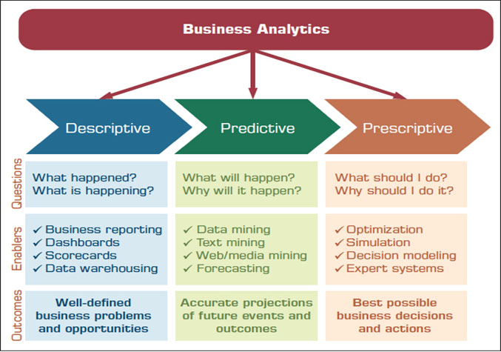
Business Analytics
Figure 1.11 Three Types of Analytics

Slide 21
Descriptive Analytics
Descriptive or reporting analytics
Answering the question of what happened
Retrospective analysis of historic data
Enablers
O L A P / D W
Data visualization
Dashboards and Scorecards
Descriptive statistics

Slide 22
Application Case 1.2
Silvaris Increases Business with Visual Analysis and Real-Time Reporting Capabilities
Questions for Discussion
What was the challenge faced by Silvaris?
How did Silvaris solve its problem using data visualization with Tableau?

Slide 23
Application Case 1.3
Siemens Reduces Cost with the Use of Data Visualization
Questions for Discussion
What challenges were faced by Siemens’ visual analytics group?
How did the data visualization tool Dundas B I help Siemens in reducing cost?

Slide 24
Predictive Analytics
Aims to determine what is likely to happen in the future (foreseeing the future events)
Looking at the past data to predict the future
Enablers
Data mining
Text mining / Web mining
Forecasting (i.e., time series)

Slide 25
Application Case 1.4
Analyzing Athletic Injuries
Questions for Discussion
What types of analytics are applied in the injury analysis?
How do visualizations aid in understanding the data and delivering insights into the data?
What is a classification problem?
What can be derived by performing sequence analysis?

Slide 26
Prescriptive Analytics
Aims to determine the best possible decision
Uses both descriptive and predictive to create the alternatives, and then determines the best one
Enablers
Optimization
Simulation
Multi-Criteria Decision Modeling
Heuristic Programming
Analytics Applied to Many Domains
Analytics or Data Science?

Slide 27
Application Case 1.5
A Specialty Steel Bar Company Uses Analytics to Determine Available-to-Promise Dates
Questions for Discussion
Why would reallocation of inventory from one customer to another be a major issue for discussion?
How could a D S S help make these decisions?

Slide 28
Analytics Examples in Selected Domains (1 of 2)
Analytics Application in HealthCare—Humana Examples
Example 1: Preventing Falls in a Senior Population—An Analytic Approach
Example 2: Humana’s Bold Goal—Application of Analytics to Define the Right Metrics
Example 3: Predictive Models to Identify the Highest Risk Membership in a Health Insurer

Slide 29
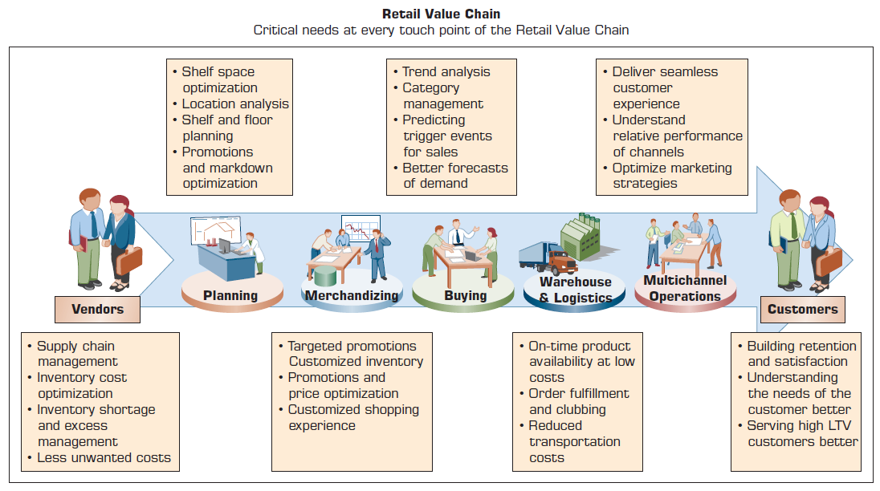
Analytics Examples in Selected Domains (2 of 2)
Analytics in Retail Value Chain
Figure 1.12 Example of Analytics Applications in a Retail Value Chain

Slide 30
Analytics Examples in Retail Value Chain
Table 1.1 Examples of Analytics Applications in the Retail Value Chain
Analytic Application | Business Question | Business Value
Inventory Optimization | 1. Which products have high demand? 2. Which products are slow moving or becoming obsolete? | 1. Forecast the consumption of fast-moving products and order them with sufficient inventory to avoid a stock-out scenario. 2. Perform fast inventory turnover of slow-moving products by combining them with one in high demand.
Price Elasticity | 1. How much net margin do I have on the product? 2. How much discount can I give on this product? | 1. Markdown prices for each product can be optimized to reduce the margin dollar loss. 2. Optimized price for the bundle of products is identified to save the margin dollar.
Market Basket Analysis | 1. What products should I combine to create a bundle offer? 2. Should I combine products based on slow-moving and fast-moving characteristics? 3. Should I create a bundle from the same category or different category line? | 1. The affinity analysis identifies the hidden correlations between the products, which can elp in following values a) Strategize the product bundle offering based on focus on inventory or margin. b) Increase cross-sell or up-sell by creating bundle from different categories or the same categories, respectively.
For the complete table, refer to your textbook

Slide 31
A Brief Introduction to Big Data Analytics
What Is Big Data? (Is it just “big”?)
Big Data is data that cannot be stored or processed easily using traditional tools/means
Big Data typically refers to data that comes in many different forms: large, structured, unstructured, continuous
3V s – Volume, Variety, Velocity
Data (Big Data or otherwise) is worthless if it does not provide business value (and for it to provide business value, it has to be analyzed)
More on Big Data Analytics is in Chapter 7

Slide 32
Application Case 1.6
CenterPoint Energy Uses Real-Time Big Data Analytics to Improve Customer Service
Questions for Discussion
How can electric companies predict possible outage at a location?
What is customer sentiment analysis?
How does customer sentiment analysis help provide a personalized service to their customers?

Slide 33
An Overview of the Analytics Ecosystem
What are the key players in analytics industry?
What do they do?
Is there a place for you to be a part of it?
There is a need to classify different industry participants in the broader view of analytics to
Identify providers (as an analytics consumer)
Identify roles to play (as a potential provider)
Identify job opportunities
Identify investment/entrepreneurial opportunities
Understand the landscape and the future of computerized decision sport systems

Slide 34
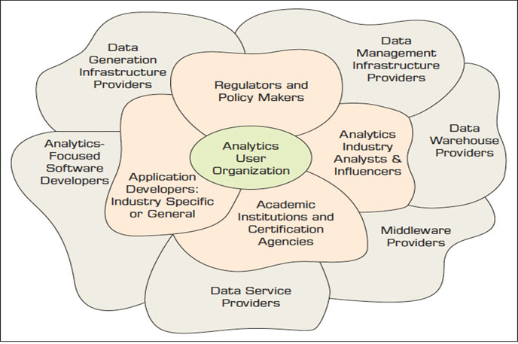
An Overview of the Analytics Ecosystem (1 of 3)
Figure 1.13 Analytics Ecosystem

Slide 35
An Overview of the Analytics Ecosystem (2 of 3)
Data Generation Infrastructure Providers
Data Management Infrastructure Providers
Data Warehouse Providers
Middleware Providers
Data Service Providers
Analytics Focused Software Developers
Descriptive, Predictive, Prescriptive
Application Developers: Industry Specific or General
Analytics Industry Analysts and Influencers

Slide 36
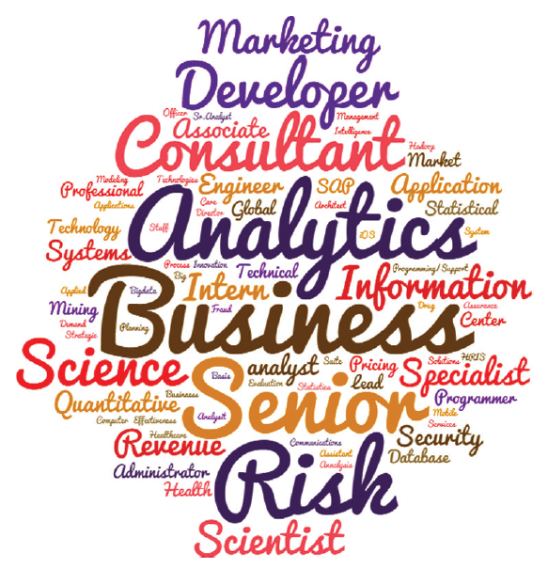
An Overview of the Analytics Ecosystem (3 of 3)
Academic Institutions and Certification Agencies
Certificates
Masters programs
Undergraduate programs
Offered by
M I S, Engineering
Marketing, Statistics
Computer Science
…
Regulators and Policy Makers
Analytics User Organizations

Slide 37
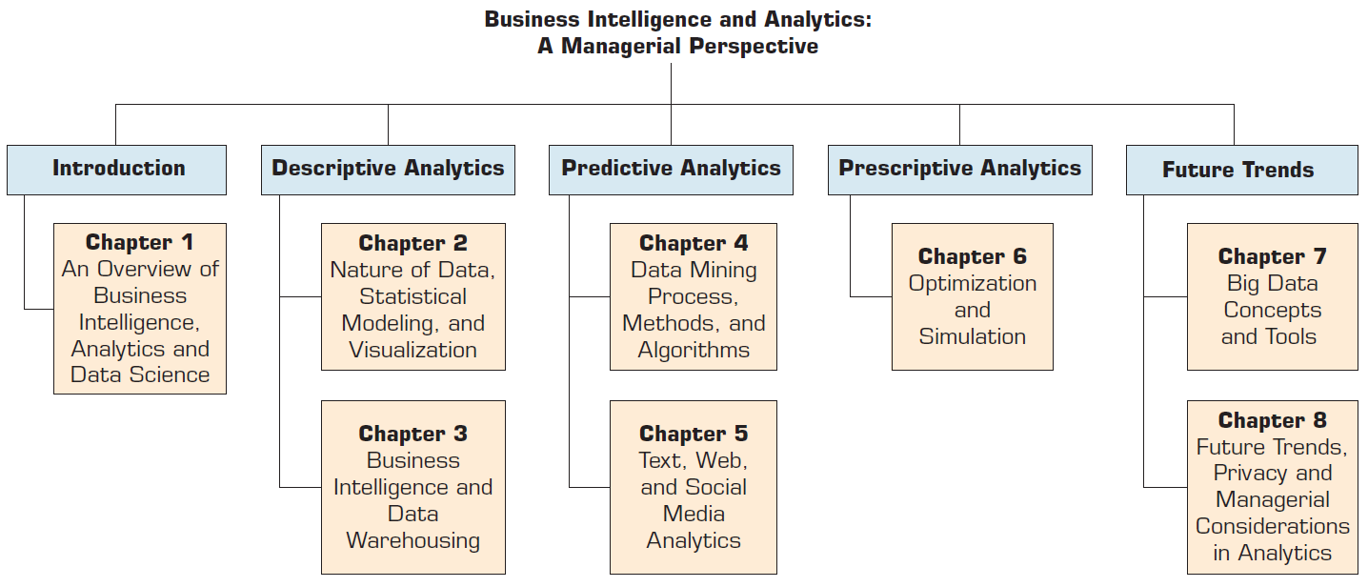
Figure 1.15 Plan of the Book

Slide 38
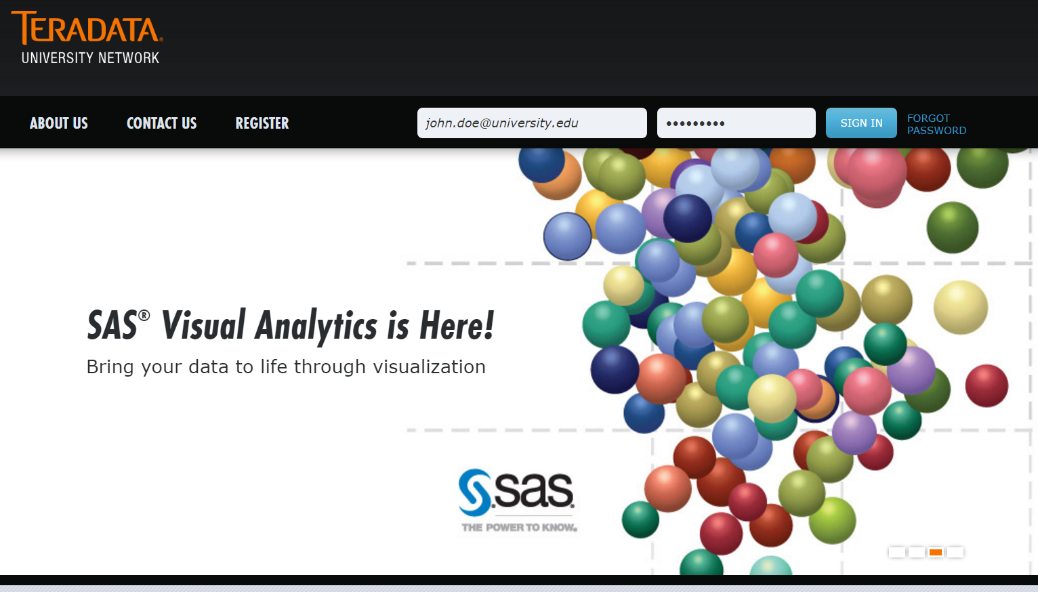
Resources
Teradata University Network (T U N)
TeradataUniversityNetwork.com

Slide 39
End of Chapter 1
Questions / Comments

Slide 40

Copyright

